Slide 1

Python in 3 Hours - Intro
For Data Analytics

Slide 2
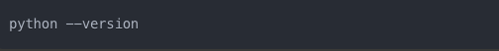
How to get it: Option 1
1. Visit the official Python website: https://www.python.org/
2. Click on the "Downloads" menu
3. Download the latest version for your operating system (Windows, macOS, or Linux)
4. Run the installer:
- On Windows: Double-click the downloaded .exe file
- On macOS: Double-click the downloaded .pkg file
- On Linux: Use your package manager or follow the instructions for your distribution
5. During installation, make sure to check the box that says "Add Python to PATH"
6. Complete the installation process
7. Verify the installation by opening a command prompt or terminal and typing:
Note: For data analytics, you might want to consider installing Anaconda instead, which includes Python and many useful data science libraries.

Slide 3
How to get it: Option 2
For data analytics, installing Anaconda is often the preferred method:
Visit the Anaconda website: https://www.anaconda.com/products/distribution
Download the Anaconda installer for your operating system
Run the installer and follow the prompts
During installation, you can choose to add Anaconda to your PATH environment variable (recommended for beginners)
Once installed, you can open Anaconda Navigator or use the Anaconda Prompt to access Python
Anaconda comes with Python pre-installed (usually the latest stable version)
It includes many popular data science libraries (numpy, pandas, matplotlib, etc.)
It provides Conda, a powerful package and environment manager
Anaconda Navigator offers a user-friendly GUI for managing environments and packages

Slide 4
Python Working Environments for Data Analytics
Jupyter Notebook/Lab: Interactive coding with cell-by-cell execution. Combines code, output, and markdown in one document. Excellent for data visualization and exploratory data analysis. Comes pre-installed with Anaconda
Google Colab: Free, cloud-based platform. No local installation required. Provides free GPU and TPU access. Easy sharing and collaboration
VS Code: Full-featured IDE with excellent debugging capabilities. Integrated terminal and version control. Supports Jupyter notebooks. Lightweight compared to full Anaconda installation

Slide 5
Running a Simple Python Script
Step 1: Create the Script
Open a text editor (e.g., Notepad, TextEdit, VS Code)
Type the following code: print("Hello, World!")
Save the file as “hello_world.py”
Step 2: Run the Script
Method 1: Using Command Line/Terminal
Open Command Prompt (Windows) or Terminal (Mac/Linux)
Navigate to the directory containing your script: cd path/to/your/script
3. Run the script: python hello_world.py

Slide 6
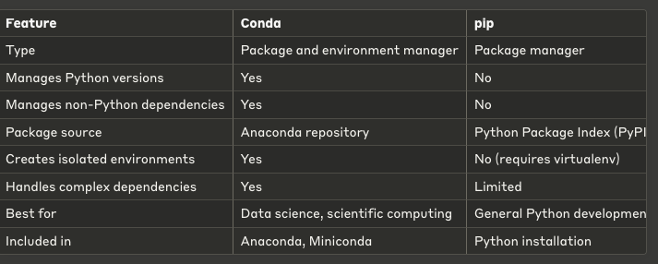
Conda vs pip
Conda is more than just a package manager; it's also an environment manager. Conda can manage packages for languages other than Python. Conda is particularly useful for data science due to its ability to manage complex dependencies.

Slide 7
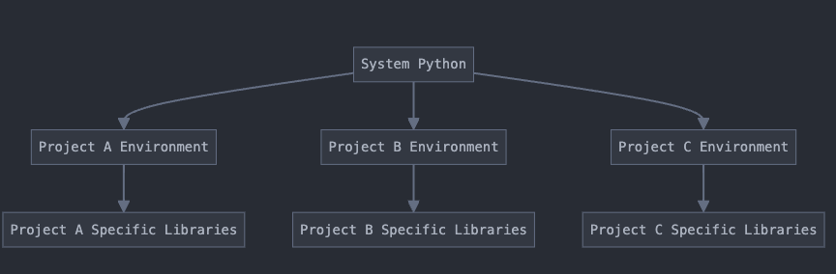
Python Environments
Python environments are isolated workspaces for Python projects. They allow you to have different versions of Python and packages for different projects. This isolation prevents conflicts between project dependencies. Environments make projects more reproducible and easier to share.
See pythonenv.ipynb & keras_setup_python.html

